Slide 1
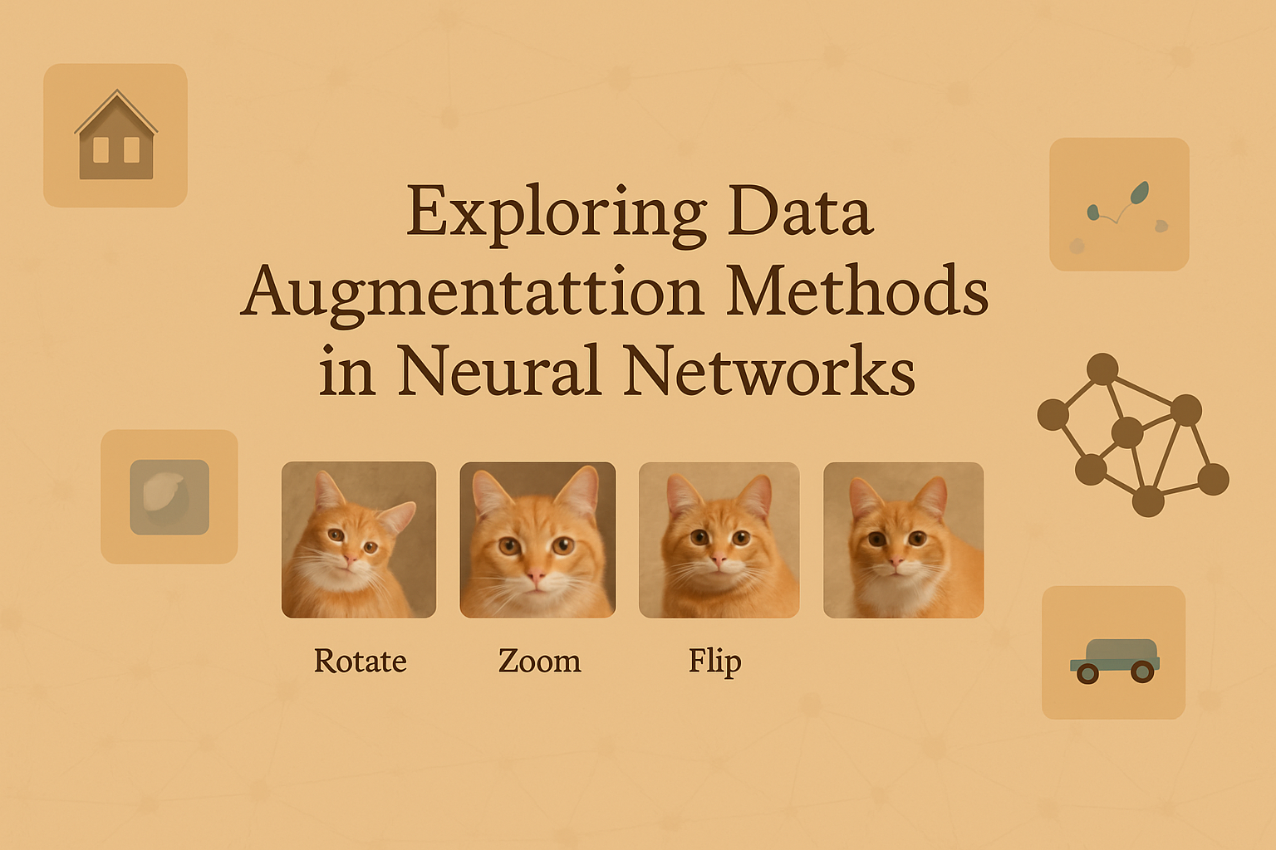
By Group 11:
Naga Sampath Maddineni
Abhiram Reddy Pudi

Slide 2
Introduction
Deep learning models require large, diverse datasets.
However, collecting large datasets is expensive and time-consuming.
Data Augmentation synthetically enlarges training data to improve generalization.

Slide 3
Motivation
Improve performance on unseen data.
Prevent overfitting in deep neural networks.
Helpful in domains with limited labeled data (e.g., medical imaging).
Original Dataset
Processing Using Data Augmentation
Large Augmented Dataset
Training (Effective Training)
Results
(Better Fitting and Generalization)

Slide 4





Project Objectives
Build a custom Data Augmentation pipeline.
Integrate a new Data Augmentation Technique(Patch Shuffle).
Test on CIFAR-10 dataset and evaluate improvements.
Compare the results with baseline techniques.

Slide 5
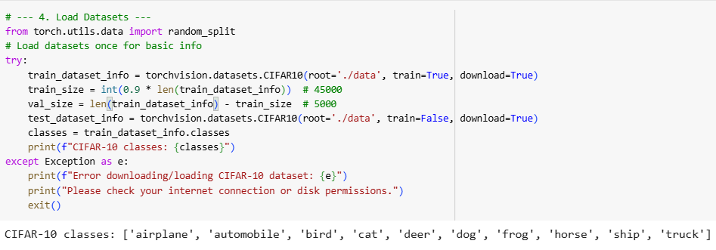
Dataset and Libraries Used
Dataset: CIFAR-10
- 60,000 images (50,000 train + 10,000 test)
- 50,000 train images spilt into 90% and 10% Training and Validation images
- 10 classes
- RGB colour, size: 32x32 pixels
- Suitable for benchmarking classification tasks.
Libraries:
- PyTorch (torch, torchvision)
- NumPy for image manipulation
- Matplotlib for visualization

Slide 6
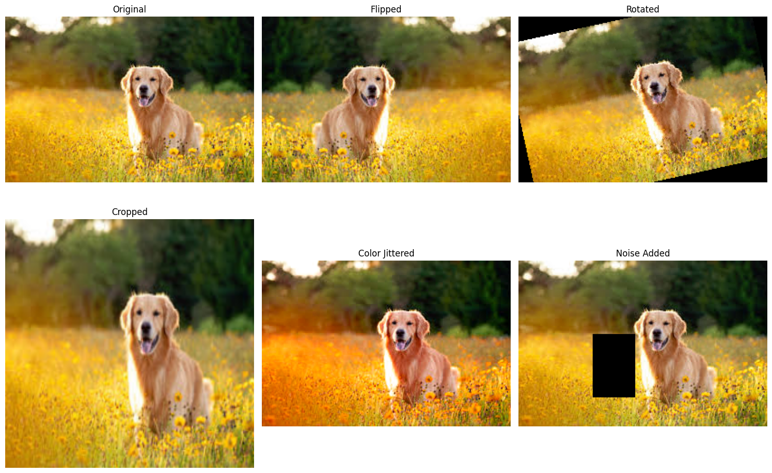
What is Data Augumentation?
METHODOLOGY
Data Augmentation is a technique to artificially expand a training dataset by creating modified versions of data samples, helping models generalize better.
Some Simple methods Includes flipping, rotating, cropping, color jittering, and adding noise.

Slide 7
What is PatchShuffle?
Patch Shuffle is a data augmentation technique where you randomly shuffle pixels in small patches (like blocks) that are inside an image to make training harder and improve generalization.
It forces a neural network to focus more on local features (like textures, edges) rather than memorizing global shapes or object positions.
Improves robustness: helps in harder tasks like object detection or classification..
Reduces overfitting: because the model sees harder, "messed up" versions of data
Makes the model learn better: it can't rely only on object shapes or locations.

Slide 8
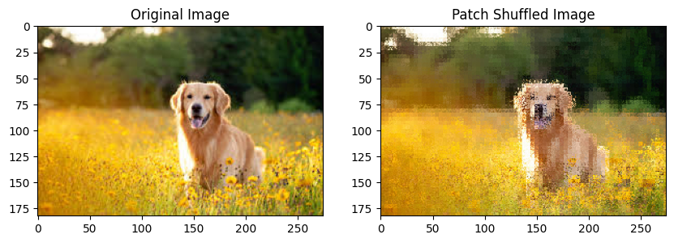
Patch Shuffle Implementation
Key steps:
- Divide image into 4x4 patches
- Randomly shuffle pixels in each patch
- Reconstruct image from shuffled patches
Applied with a set probability (e.g., 30%)

Slide 9
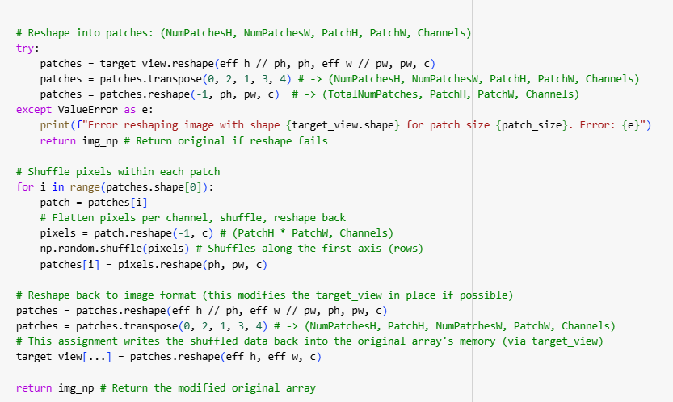
PatchShuffle - Code Summary

Slide 10
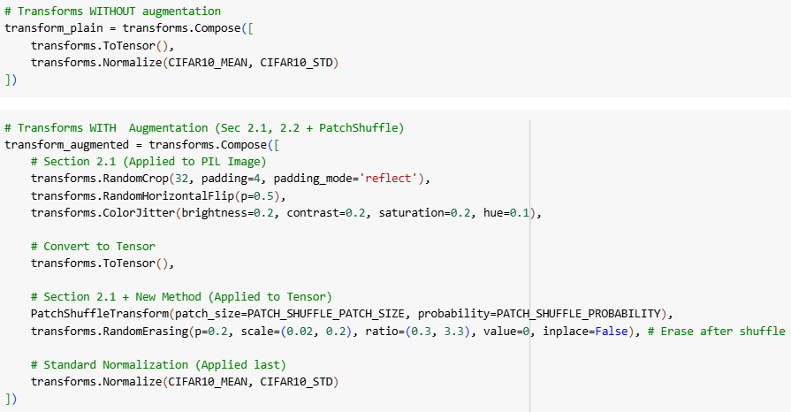
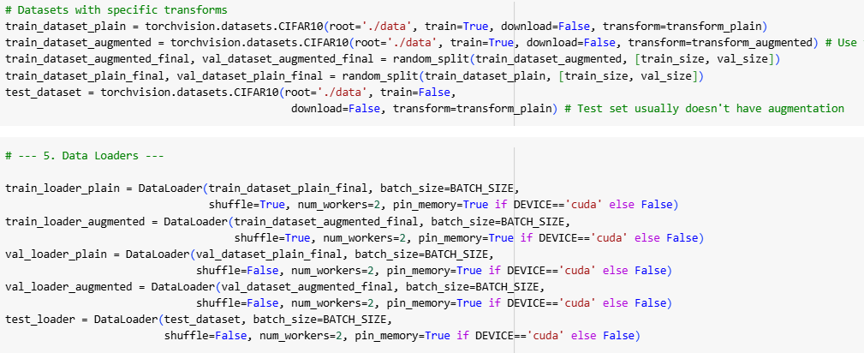
Dataset Transformation Pipeline for Baseline (without Augmnentation) and With Augumentation

Slide 11
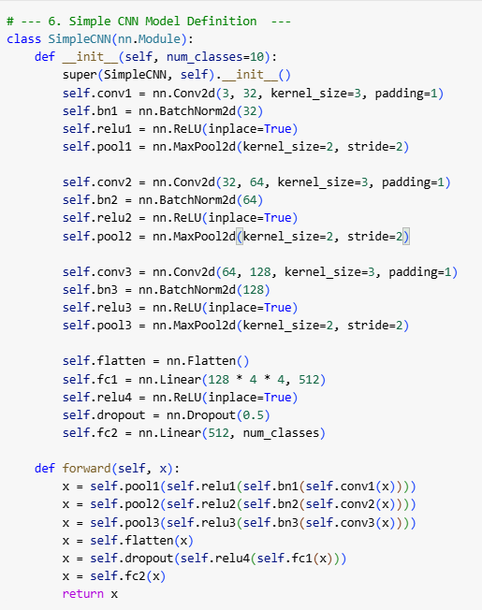
Model Architecture
Neural Network: A simple custom CNN Classification Model
Architecture:
CNN: 3 blocks, each block has Conv → BatchNorm → ReLU → MaxPool.
Flatten: Converts feature maps into a 1D vector.
FC Layers: One dense layer with ReLU + Dropout, then final dense layer for classes.
Final classification layer: A second dense layer that outputs class scores for prediction.

Slide 12
Training Setup
The dataset is preprocessed with augmentation techniques and split into training, validation and testing datasets.
The training is done on Training and Validation sets and finally evaluated on the Testing set after training.
The below parameters and criteria are used for training
Hyperparameters:
- Batch size: 128
- Epochs: 100
- Learning rate: 0.001
Optimized using the Adam optimizer.
Trained using standard cross-entropy loss Criterion.

Slide 13
Evaluation Metrics & Results
Classification Accuracy Results on CIFAR-10:
There is an ~5%(5.3%) increase in Test accuracy.(changes for every runtime)
Decrease in Train accuracy and increase in Validation accuracy in the accuracy curves indicates the better generalization after Augmentation in feature space.
The training time has increased for augmentation due complex and increased data with noise so feature identification of the images requires more time.
Metrics | Baseline | With Augmentation
Train Accuracy | 0.9872 | 0.7632
Test Accuracy | 0.7914 | 0.8453
Training Time | 22m 27s | 93m 52s

Slide 14
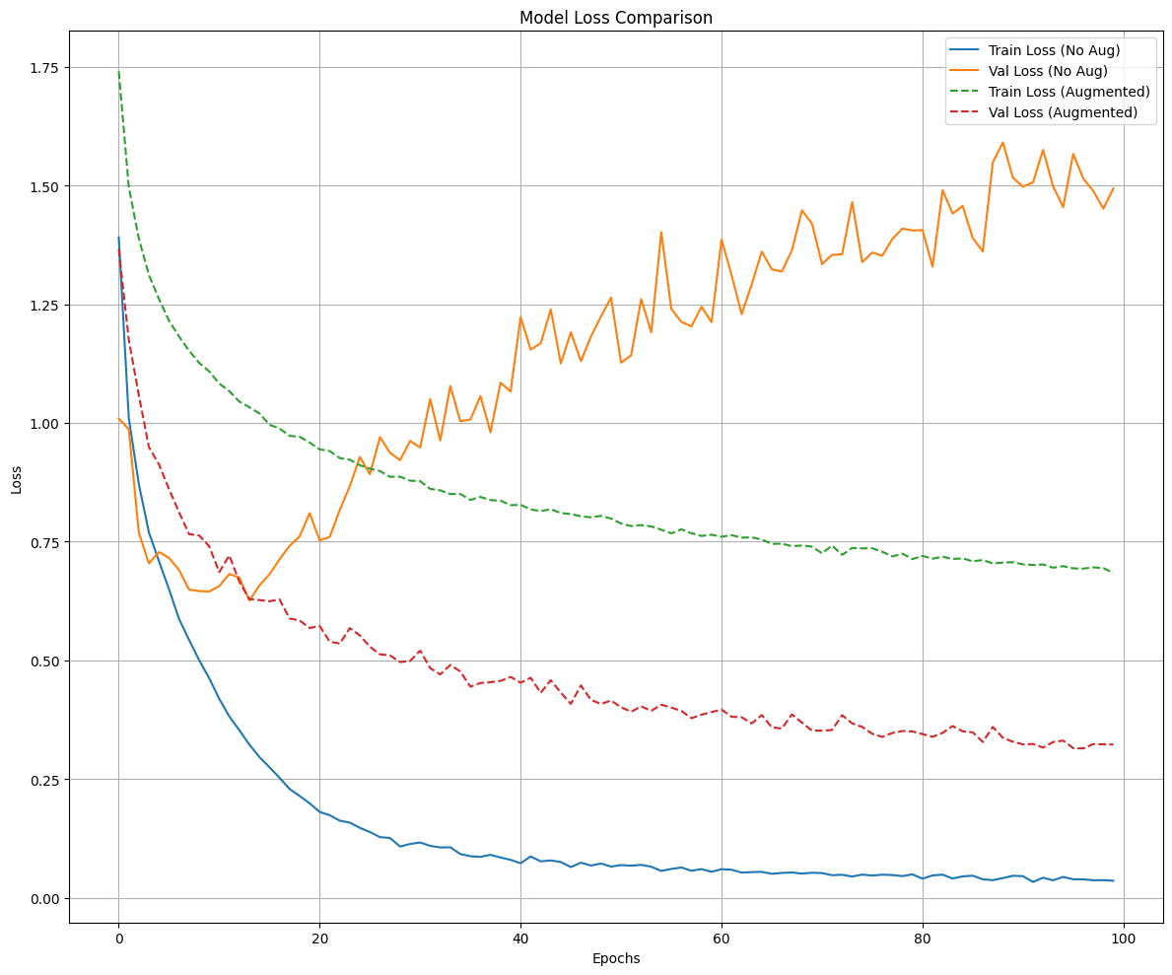
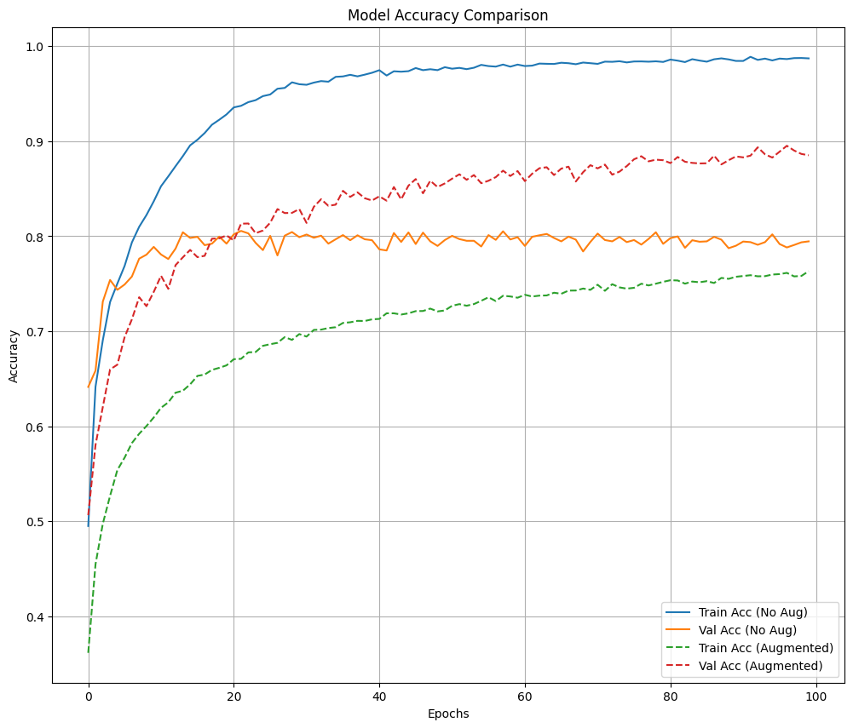
Accuracy and Loss curves

Slide 15
Augmentation Effect on Features
Better generalization in feature space and reduction of overfitting.
Model less sensitive to background artifacts and will have improved robustness to noise and real-world distortions
Stronger classification boundaries meaning will have Smooth decision boundaries in feature space.
Reduces dataset bias because it forces model to perform well on a broader distribution rather than just training distribution

Slide 16

Challenges and Insights
Challenges faced:
- Implementing PatchShuffle with consistent output
- Managing GPU memory with complex transforms
- Debugging training instabilities
Insights and Discussion:
- PatchShuffle complements spatial and color augmentations
- Too much augmentation can hurt performance

Slide 17
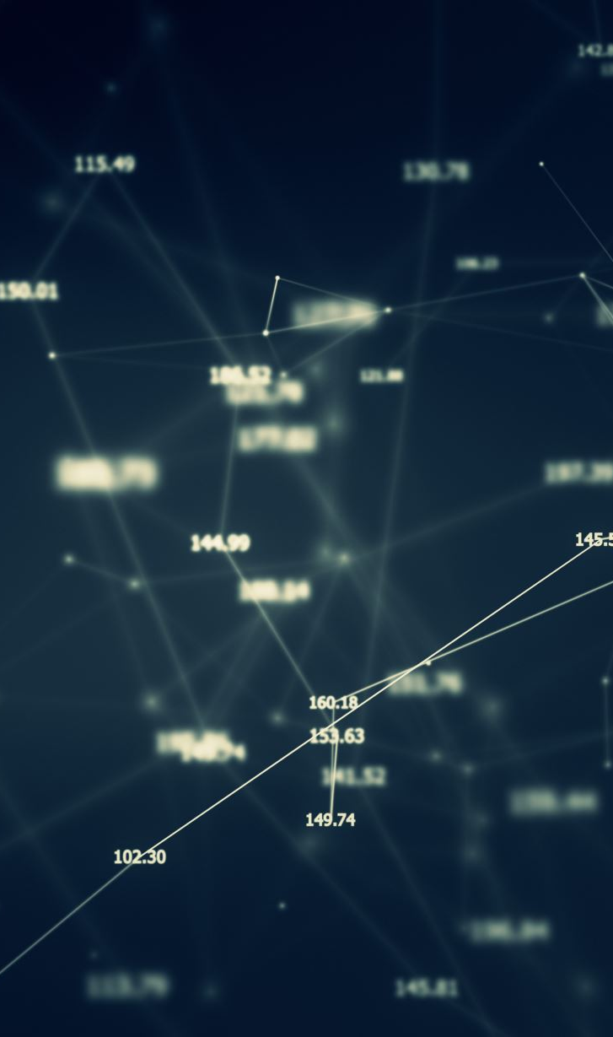
Future Directions
- Explore AutoAugment + PatchShuffle
- Try on other datasets (e.g., CIFAR100, SVHN, TinyImageNet)
- Augmentations for segmentation and detection tasks

Slide 18
Conclusion
Data augmentation significantly improves classification and provides better Generalization.
PatchShuffle proved useful in promoting robustness by encouraging invariance to noise.
Project delivered reproducible and extendable codebase.

Slide 19
References
Suorong Yang, Weikang Xiao, Image Data Augmentation for Deep Learning: A Survey arXiv:2204.08610v2 [cs.CV] 5 Nov 2023.
Zhang, X., Wang, Y., Li, P., & Chen, J. (2024). Toward robustness in multi-label classification: A data augmentation strategy against imbalance and noise. In Proceedings of the AAAI Conference on Artificial Intelligence, 2024.
Goyal, Y., Wu, Y., Bigham, J. P., & Zhang, A. G. (2021). Explanation-based data augmentation for image classification. In Advances in Neural Information Processing Systems (NeurIPS), 2021.
Yun, S., Han, D., Oh, S. J., Chun, S., Choe, J., & Yoo, Y. (2019): CutMix: Regularization Strategy to Train Strong Classifiers with Localizable Features, presented at the IEEE International Conference on Computer Vision (ICCV) in 2019

Slide 20
Thank you

